Slide 1

“A RELATIONAL MODEL OF DATA FOR LARGE SHARED DATA BANKS”
By
SHOBIKA R
19S034

Slide 2
Introduction
Edgar F. Codd, popularly known as “Father of Relational Database Management System”, is a mathematician and computer scientist who laid the theoretical foundation for relational databases--the standard method by which information is organized in and retrieved from computers.
The paper, “A Relational Model of Data for large Shared Data Banks,” by Dr. E. F. Codd, was published in June 1970 in Communications of the ACM. Codd’s model is now accepted as the definitive model for relational database management systems (RDBMS).
The language, Structured Query Language (SQL) was developed by IBM to use Codd’s model.

Slide 3
Citation
Future users of large data banks must be protected from having to know how the data is organized in the machine (the internal representation). A prompting service which supplies such information is not a satisfactory solution. Activities of users at terminals and most application programs should remain unaffected when the internal representation of data is changed and even when some aspects of the external representation are changed. Changes in data representation will often be needed as a result of changes in query, update, and report traffic and natural growth in the types of stored information. Existing non-inferential, formatted data systems provide users with tree-structured files or slightly more general network models of the data.

Slide 4
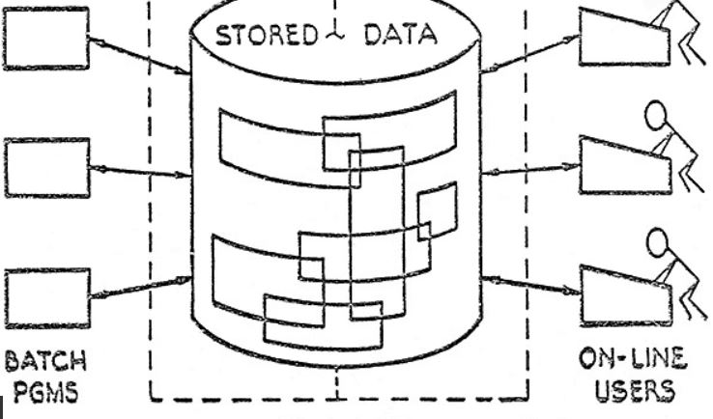
Overview
Relational model provides a means of describing data with its natural structure only--that is, without superimposing any additional structure for machine representation purposes. Accordingly, it provides a basis for a high level data language which will yield maximal independence between programs on the one hand and machine representation and organization of data on the other.
Codd wanted to show how information stored in large databases could be accessed without knowing how the information was structured or where it resided in the database.

Slide 5
SECTION 1: Relational Model and Normal Form
Data dependencies in present systems
Ordering
Indexing
Access Path
A relational view of Data
Normal Form
Some Linguistic Aspects

Slide 6
Data dependencies in present systems
The provision of data description tables in recently developed information systems represent a major advance towards the goal of “data independency”.
Such tables facilitate changing certain characteristics of the data representation stored in data banks.
However, the variety of data representation characteristics which can be changed without logically impairing the application programs is still limited.
Three of the principal kinds of data which has to be removed are
Ordering Dependence
Indexing Dependence
Access path Dependence

Slide 7
Ordering Dependency
Let us consider the existing systems which either require or permit data elements to be stored in at least one total ordering which is closely associated with the hardware-determined ordering of addresses.
For example,
Let us consider a simple data set involving machine parts and assembly projects.
The records of a file concerning parts might be stored in ascending order by part serial number. Such systems normally permit application programs to assume that the order of presentation of records is similar to stored ordering. Those applications are likely to fail to operate correctly if for some reason it becomes necessary to replace that ordering by a different one.

Slide 8
Indexing Dependency
In the context of formatted data, an index is usually thought of as a purely performance-oriented component of the data representation.
It improves response to queries and updates and, at the same time, it slows down response to insertions and deletions.
Can application programs and terminal activities remain invariant as indices come and go ??
At that time IBM was promoting its newly released hierarchical database system IMS (Information Management system) that had a choice between indexing.
Another Time shared data management system is IDS that allowed file designers to select attributes to be indexed and to incorporate them using indexing chains.

Slide 9
Access Path Dependence
Many of the existing formatted data systems provide users with tree structured files or slightly more general networked models of the data.
Application programs developed to work with these systems tend to be logically impaired if the trees or networks are changed in structure.
Ex : Considering the example of databank containing Parts and Projects,
Part may contain part number, part name and part description while Project may contain details like project number, project name and project description.
Whenever a project makes use of a part, the quantity of the part committed to the project is also recorded.
If we are to design the data in terms of structures, one of the following hierarchical structures may be produced for the given information.

Slide 10
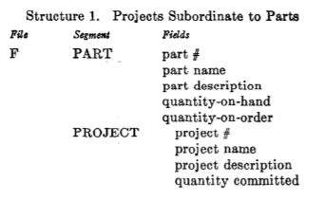
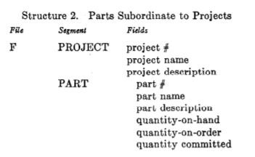
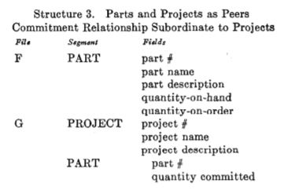
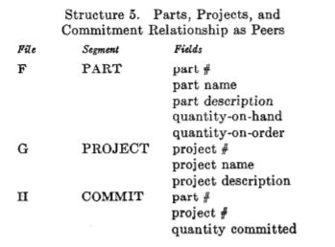
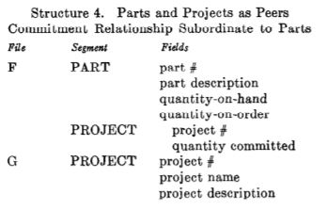

Slide 11
If we are to print the part name, number and quantity committed for every part for a particular project, regardless of the system used to tackle ths project, the following observations may be made.
If a program P is developed for this problem assuming one of the five structures, without testing which structure goes into effect – then P will fail in at least three of the remaining structures.
In the absence of a test to determine which structure is employed, P fails because an attempt is made to execute a reference to a non-existent file or no attempt is made to execute the reference.
Since, in general, it is not practical to develop application programs which test for all tree structures permitted by the system, these programs fail when a change in the structure becomes necessary.
A solution to this problem was to adopt a policy that once a user path is defined, it will not be made obsolete until all applications that uses the path becomes obsolete, which is not practical considering the number of access paths in the total model for the community of users of a data bank is excessively large.

Slide 12
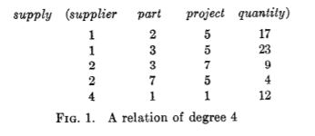
A Relational View Of Data
The term relation is used here in its accepted mathematical sense. Given sets S1,S2,...,Sn (not necessarily distinct), R is a relation on these n sets if it is a set of n-tuples each of which has its first element from S1, its second element from S2, and so on. We shall refer to Sj as the jth domain of R. As defined above, R is said to have degree n.
Relations of degree 1 are often called unary, degree 2 binary, degree 3 ternary, and degree n n-ary.
The following is a relation of degree 4, called supply, which reflects the shipments-in-progress of parts from specified suppliers to specified projects in specified quantities.

Slide 13
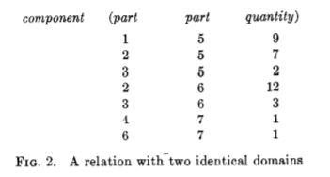
“An array which represents an n-ary relation R has the following properties:
(1) Each row represents an n-tuple of R.
(2) The ordering of rows is immaterial.
(3) All rows are distinct.
(4) The ordering of columns is significant — it corresponds to the ordering S1, S2, …, Sn of the domains on which R is defined (see, however, remarks below on domain-ordered and domain-unordered relations).
(5) The significance of each column is partially conveyed by labeling it with the name of the corresponding domain.”
The ordering of column matters because as like in the following relation called component, a ternary relation whose first two domains are ambiguous in name but possess distinct meanings with respect to the relation.

Slide 14
The meaning of component (x,y,z) is that part x is an immediate component of part y, and z units of part x are needed to assemble one unit of part y. It is a relation which plays a critical role in the parts explosion problem.
Encountering Relationships :
The totality of data in a data bank may be viewed as a collection of time-varying relations. These relations are of assorted degrees. As time progresses, each n-ary relation may be subject to insertion of additional n-tuples, deletion of existing ones, and alteration of components of any of its existing n-tuples.
With large databases users cannot be burdened with remembering the domain names or deal with relations that are domain ordered, but with relationships which are their domain-unordered counterparts.
Thus, where there are two or more identical domains, we require in each case that the domain name be qualified by a distinctive role name, which serves to identify the role played by that domain in the given relation.

Slide 15
Terms :
Consider an example of a data bank which includes relations concerning parts, projects, and suppliers. One relation called part is defined on the following domains:
(1) part number (2) part name (3) part color (4) part weight (5) quantity on hand (6) quantity on order
and possibly other domains as well. Each of these domains is, in effect, a pool of values, some or all of which may be represented in the data bank at any instant.
While it is conceivable that, at some instant, all part colors are present, it is unlikely that all possible part weights, part names, and part numbers are. We shall call the set of values represented at some instant the active domain at that instant.
Normally, one domain (or combination of domains) of a given relation has values which uniquely identify each element (n-tuple) of that relation. Such a domain (or combination) is called a primary key.

Slide 16
Keys provide a user-oriented means (but not the only means) of expressing such cross-references. We shall call a domain (or domain combination) of relation R a foreign key if it is not the primary key of R but its elements are values of the primary key of some relation S.
Examples of relations which are defined on simple domains, domains whose elements are atomic (non-decomposable) values were referred.
Nonatomic values can be discussed within the relational framework. Thus, some domains may have relations as elements. These relations may, in turn, be defined on nonsimple domains, and so on.
For example,
One of the domains on which the relation employee is defined might be salary history. An element of the salary history domain is a binary relation defined on the domain date and the domain salary. The salary history domain is the set of all such binary relations.

Slide 17
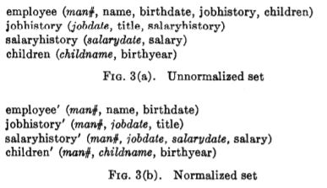
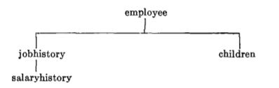
Normal Form
A relation whose domains are all simple can be represented in storage by a two-dimensional column-homogeneous array of the kind discussed above. Some more complicated data structure is necessary for a relation with one or more non-simple domains. There is, in fact, a very simple elimination procedure, which we shall call normalization.
For example,
Job history and children are nonsimple domains of the relation employee. Salary history is a nonsimple domain of the relation job history.
The tree shows these interrelationships of the nonsimple domains with difference between the Unnormalized and Normalized.

Slide 18
Some Linguistic Aspects
The adoption of a relational model of data, as described above, permits the development of a universal data sublanguage based on an applied predicate calculus.
The universality of the data sublanguage lies in its descriptive ability (not its computing ability).

Slide 19
SECTION 2: Redundancy and Consistency
Operations on relations
Permutation
Projection
Join
Composition
Restriction
Redundancy: Strong and Weak redundancy
Consistency

Slide 20
Thanking You

